Slide 1
Java Basics
Guangjian Zhou

Slide 2
1. What’s the difference between JDK and JRE?
JDK stands for Java Development Kit. It is a software development environment used to develop Java applications and applets. It is a platform-specific software i.e there are separate installers for Windows, Mac, and Unix systems. Java developers can use it on their Windows, macOS, Solaris, and Linux to code and run Java programs. It contains Java Runtime Environment(JRE) and other development tools like an interpreter, compiler, archiver, and a document generator. We can possibly install more than one JDK version on the same computer.
JRE stands for Java Runtime Environment. It is the implementation of JVM (Java Virtual Machine) and it is specially designed to provide an environment to execute Java programs. It is also platform dependent like JDK. It consists of JVM, Java binaries, and other classes for the smooth execution of the program. It doesn’t contain any development tools like a compiler, debugger, etc. If we only want to execute a program, we just need to install JRE and not JDK, since there is no development or compilation of the code required.

Slide 3
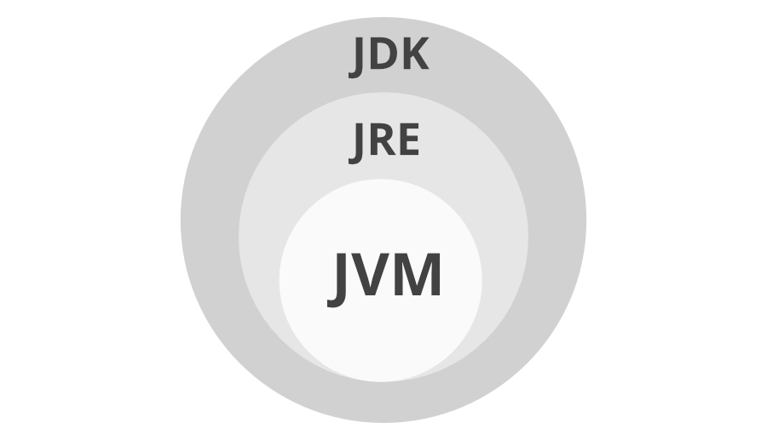
2. What is Java Virtual Machine?
JVM(Java Virtual Machine) acts as a run-time engine to run Java applications. JVM is the one that actually calls the main method present in a java code. JVM is a part of JRE(Java Runtime Environment).
Java applications are called WORA (Write Once Run Anywhere). This means a programmer can develop Java code on one system and can expect it to run on any other Java-enabled system without any adjustment. This is all possible because of JVM.
When we compile a .java file, .class files(contains byte-code) with the same class names present in .java file are generated by the Java compiler. This .class file goes into various steps when we run it. These steps together describe the whole JVM.

Slide 4
3. What are the different types of memory areas allocated by JVM?
The memory in the JVM is divided into 5 different parts:
Class(Method) Area :
class code, variable code, class-level data(constant pool, field and method data)
Heap
objects (at run time)
3.Stackore data and partial results
4.Program Counter Register
5.Native Method Stack

Slide 5
4. What is JIT compiler?
The Just-In-Time (JIT) compiler is an essential part of the JRE i.e. Java Runtime Environment, that is responsible for performance optimization of java based applications at run time. The compiler is one of the key aspects in deciding the performance of an application for both parties i.e. the end-user and the application developer.
Bytecode is one of the most important features of java that aids in cross-platform execution. The way of converting bytecode to native machine language for execution has a huge impact on its speed of it. These Bytecode have to be interpreted or compiled to proper machine instructions depending on the instruction set architecture. Moreover, these can be directly executed if the instruction architecture is bytecode based.

Slide 6
4. What is JIT compiler? Con’d
Interpreting the bytecode affects the speed of execution. In order to improve performance, JIT compilers interact with the Java Virtual Machine (JVM) at run time and compile suitable bytecode sequences into native machine code. While using a JIT compiler, the hardware is able to execute the native code, as compared to having the JVM interpret the same sequence of bytecode repeatedly and incurring overhead for the translation process. This subsequently leads to performance gains in the execution speed, unless the compiled methods are executed less frequently. The JIT compiler is able to perform certain simple optimizations while compiling a series of bytecode to native machine language. Some of these optimizations performed by JIT compilers are data analysis, reduction of memory accesses by register allocation, translation from stack operations to register operations, elimination of common sub-expressions, etc. The greater is the degree of optimization done, the more time a JIT compiler spends in the execution stage. Therefore it cannot afford to do all the optimizations that a static compiler is capable of, because of the extra overhead added to the execution time and moreover it’s view of the program is also restricted.

Slide 7
5. What are the main differences between Java platforms and
The main differences between the Java platform and other platforms are:
Java is platform independent because of this characteristic we can write Java code in one platform and can be read/run in/on any other platform i.e WORA(Write Once Read Anywhere). Other languages lack this capability.
Java platform is a software-only platform that runs on the top of other hardware-based platforms, other platforms are mostly hardware software or hardware only and can be run only on hardware based.
Programmer can develop Java code on any OS. Most of the other platforms do not have this capability.
Java has its own run time environment known as JRE(Java Run-time Environment) and Java Virtual Machine(JVM) which converts Java code to machine code, whereas this functionality is missing in other platforms.

Slide 8
6. Why people say that java is ‘write once and run anywhere’ language?
Java applications are called WORA (Write Once Run Anywhere). This means a programmer can develop Java code on one system and can expect it to run on any other Java-enabled system without any adjustment. This is all possible because of JVM
In traditional programming languages like C, C++ when programs were compiled, they used to be converted into the code understood by the particular underlying hardware, so If we try to run the same code at another machine with different hardware, which understands different code will cause an error, so you have to re-compile the code to be understood by the new hardware.
In Java, the program is not converted to code directly understood by Hardware, rather it is converted to bytecode(.class file), which is interpreted by JVM, so once compiled it generates bytecode file, which can be run anywhere (any machine) which has JVM( Java Virtual Machine) and hence it gets the nature of Write Once and Run Anywhere.

Slide 9
7. How does ClassLoader work in Java?
The Java ClassLoader is a part of the Java Runtime Environment that dynamically loads Java classes into the Java Virtual Machine. The Java run time system does not need to know about files and file systems because of classloaders. Java classes aren’t loaded into memory all at once, but when required by an application. At this point, the Java ClassLoader is called by the JRE and these ClassLoaders load classes into memory dynamically.

Slide 10
8. Do you think ‘main’ used for main method is a key word in Java?
It is the name of the Java main method. It is the identifier that the JVM looks for as the starting point of the java program. It’s not a keyword.

Slide 11
9. Can we write main method as public void static instead of public static void?
No. It causes syntax error.

Slide 12
10. In Java, if we do not specify any value for local variable, then what will be the default value for local variables?
There is no default value for local variables, so local variables should be declared and an initial value should be assigned before the first use. otherwise, the compiler throws an error.

Slide 13
11. Let say we run a java class without passing any arguments. What will be the value of String array of arguments in Main method?
It will be an empty String array.

Slide 14
12. In Java, if we do not specify any value for local variable, then what will be the default value for local variables?
The main difference between a byte and char data type is that byte is used to store raw binary data while other is used to store characters or text data.
The size of the byte variable is 8 bit while the size of the char variable is 16 bit. One more difference between char and byte is that byte can represent negative values as well but char can only represent positive values as its range is from 0 to 255.

